Slide 1
P#
<Computational Design Thinking>
<Generative Design>
P#
Assignment
Context
Course
Date
Generative
Design
Freshmore
Term 1
Computational
Design Thinking
2023
<Overview Description>
The design of the ‘Abstract Spiral Tower' is a multi-layered circle-spiral 3D model.
The idea started from rotational symmetry art, where a pattern is created, and then rotated about a central pivot for 360 degrees to create a circular symmetrical art (an example of such art is the pattern of snowflakes). In this design, that pattern is a spiral.
The building process involves creating a circle of multiple points, then creating a separate functions workflow that creates the spiral model, then placing the spiral pattern on each of these points of the circle to create a circle-spiral model, and lastly, duplicating this circle-spiral model multiple times, with varying radius, height and colour to create the final ‘Abstract Spiral Tower’ 3D model.
A key challenge was to adapt the spiral pattern geometry onto each point on the circle to create the final product, which I managed to overcome using the 'Vector 2Pt' and 'Move' commands in Grasshopper to shift the spiral pattern into each individual points of the circle.

Slide 2
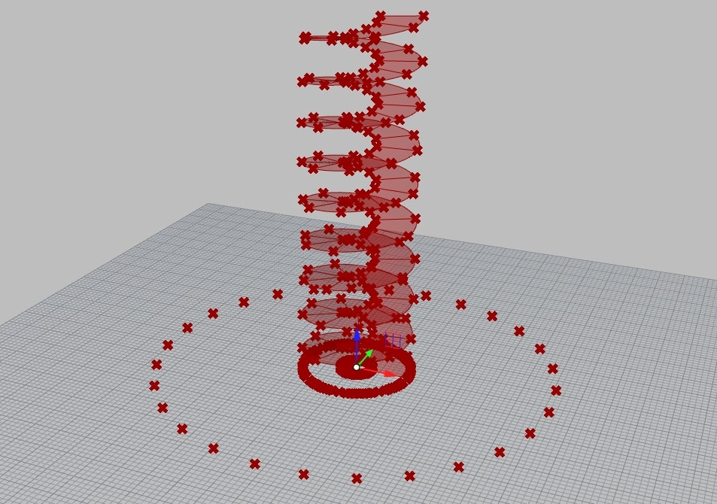
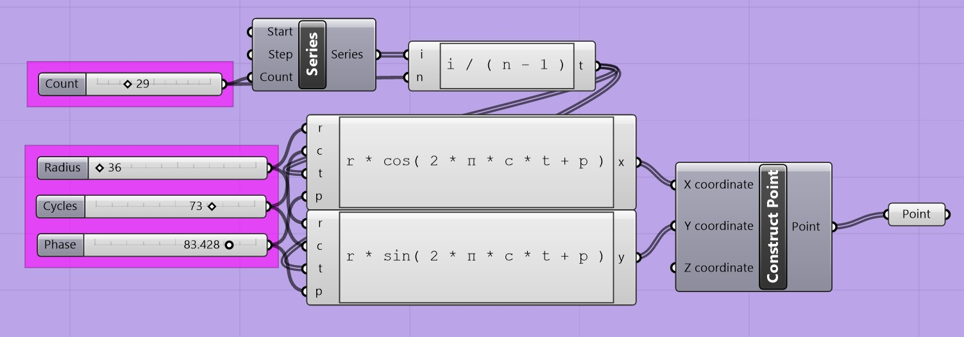
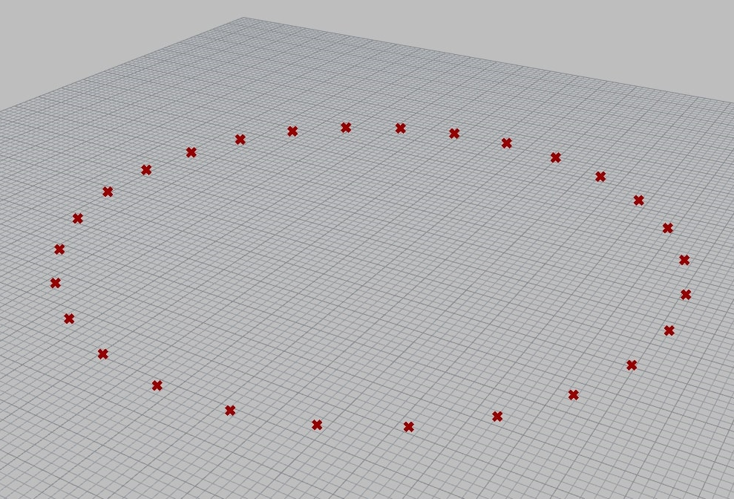
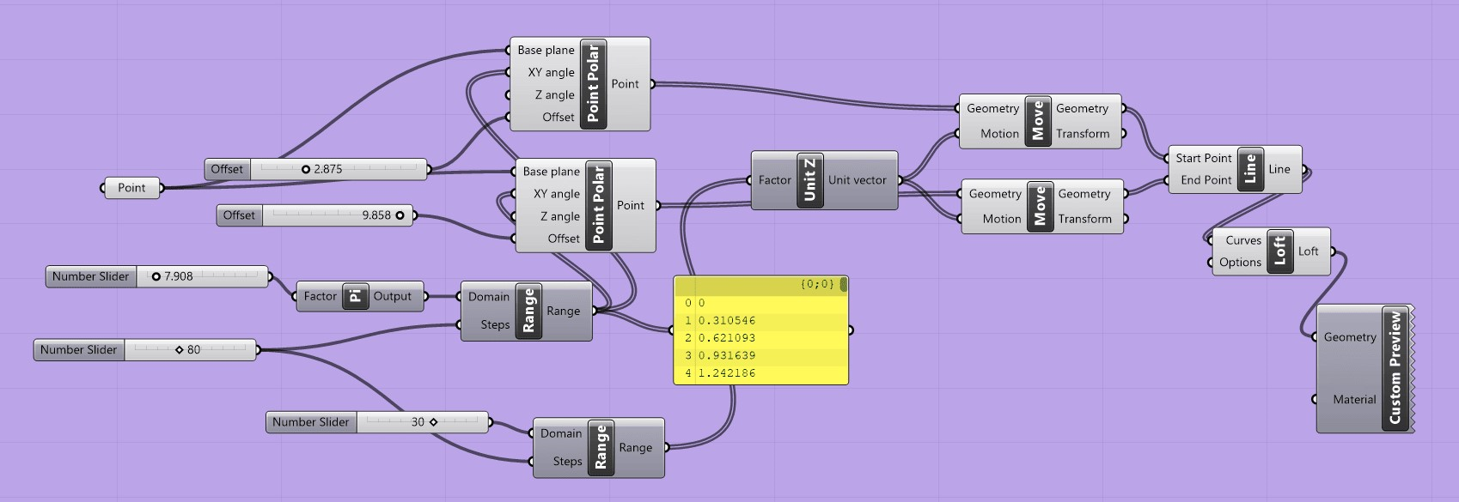
P#
<Computational Design Thinking>
<Generative Design>
P#
References
<Building Process Part 1>
Step 1 of building the 3D model is by creating multiple points in a circle. The idea was inspired from the SUTD Computational Thinking and Design, Associative Modelling, Generalized Circles, ASD course notes. (see picture 01 for the model and picture 03 for the Grasshopper code).
Step 2 of building the 3D model is by creating the spiral model. The idea was inspired from the Youtube channel ‘How to Rhino’ video on ‘Grasshopper Tutorial | Spiral Surfaces’. (see picture 02 for the model and picture 04 for the Grasshopper code)
The 2 separate groups of Grasshopper code, one which creates the circle of points (see picture 03), and the other which creates the spiral model (see picture 04), will later be combined and grouped together in step 3 of the building process in the next slide via the ‘Vector 2Pt’ and ‘Move’ functions in Grasshopper.
02
How to Rhino. “Grasshopper Tutorial | Spiral Surfaces” YouTube video. Jul 23, 2020 https://www.youtube.com/watch?v=BwcCmKAmaVI
SUTD. “Computational Thinking and Design, Associative Modelling, Generalized Circles” ASD course notes. 2020 http://asd.courses.sutd.edu.sg/cdt/associative-modeling/3/
01
03
Captions
01 Circle of points
02 Spiral model
03 Grasshopper code to create the model in ‘01’
04 Grasshopper code to create the model in ‘02’
04

Slide 3
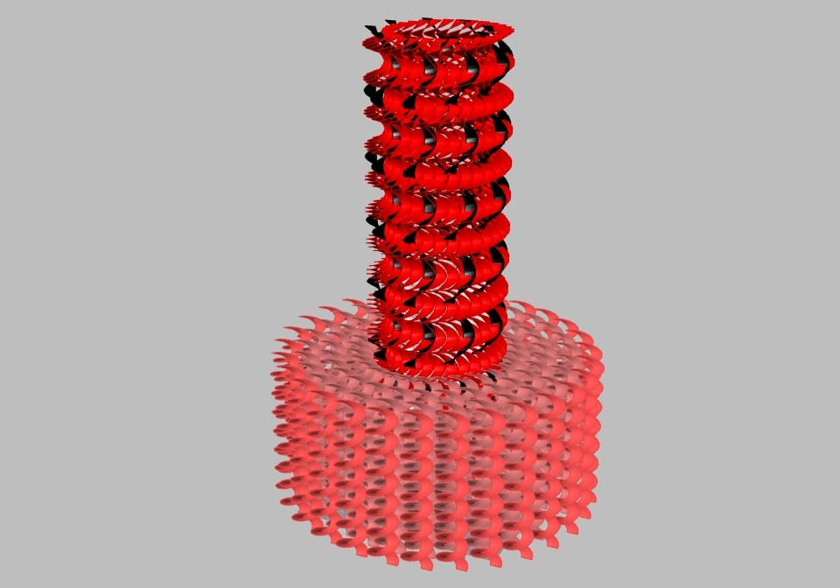
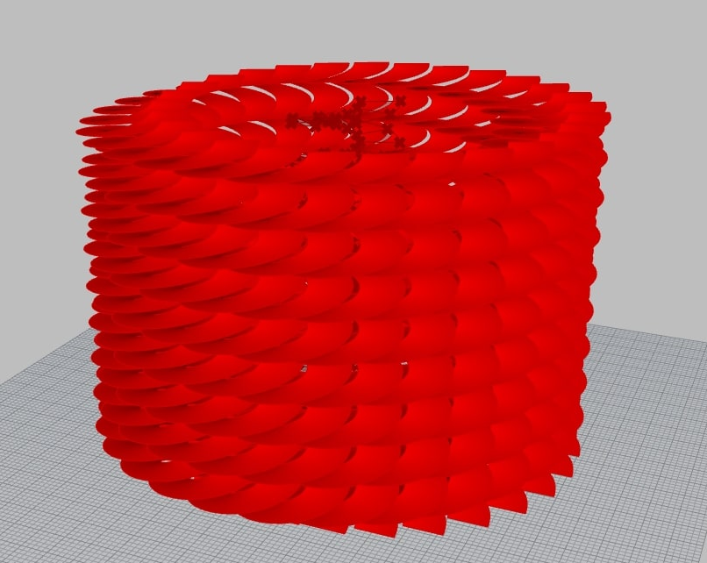
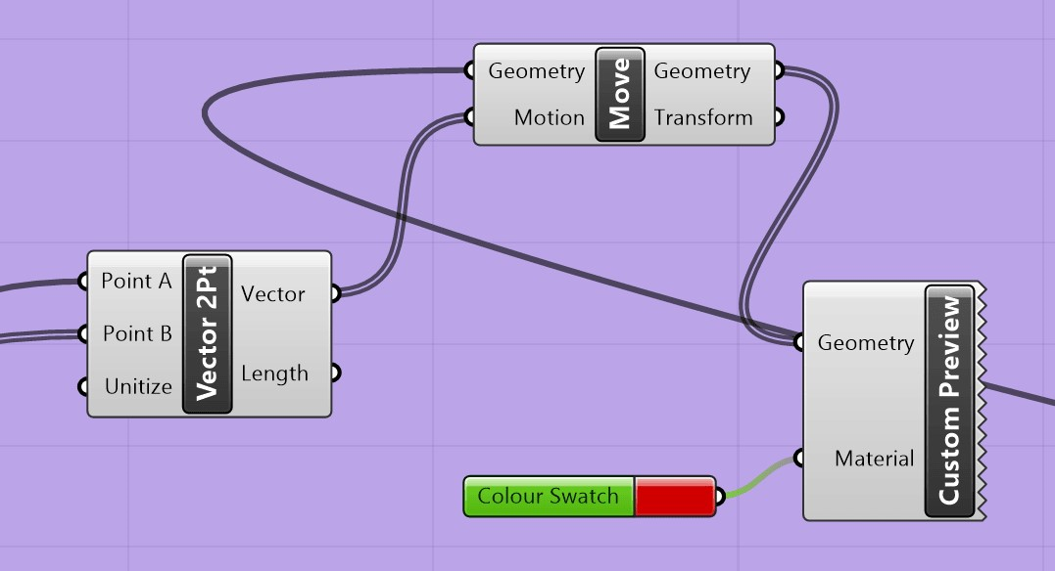
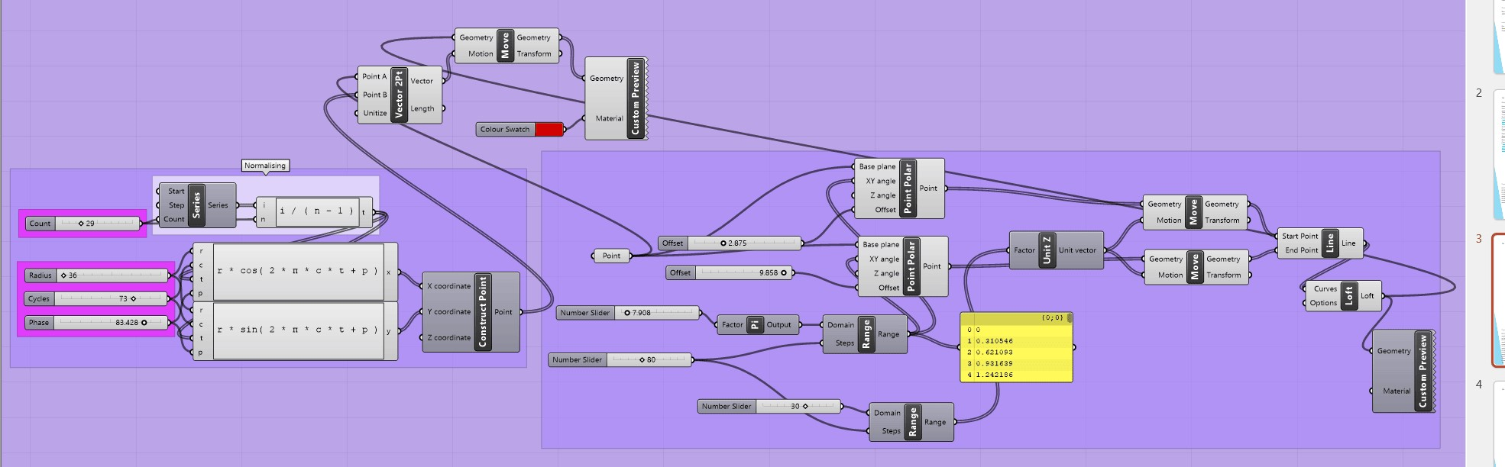
P#
<Computational Design Thinking>
<Generative Design>
P#
<Building Process Part 2>
Step 3 of building the 3D model is by creating a spiral model on each of the multiple points on the circle to form the model in picture 01. I made use of the ‘Vector 2Pt’ and ‘Move’ functions in Grasshopper to combine the 2 separate groups of Grasshoppper code (see picture 03 and 04 in the previous slide), and while doing so, allows me to move the spiral model to each of the multiple points on the circle, creating a circle-spiral model. (see picture 01 for the model and picture 03 for the Grasshopper code of the ‘Vector 2Pt’ and ‘Move’ functions)
Step 4 of building the 3D model is by duplicating the circle-spiral model in picture 01, with picture 04 showing the full Grasshopper code of the circle-spiral model in picture 01, with a more complete Grasshopper code of the complete 3D model and explanation of step 4 of building the 3D model in the next slide.
02
01
03
03
Captions
01 Creating a spiral model at each point in the circle of points
02 Duplicating the model in ‘03’ to create multiple layers to create the final 3D model
03 Grasshopper code to create the model in ’03’
04 Part of the Grasshopper code to create the model in ’04’
04

Slide 4
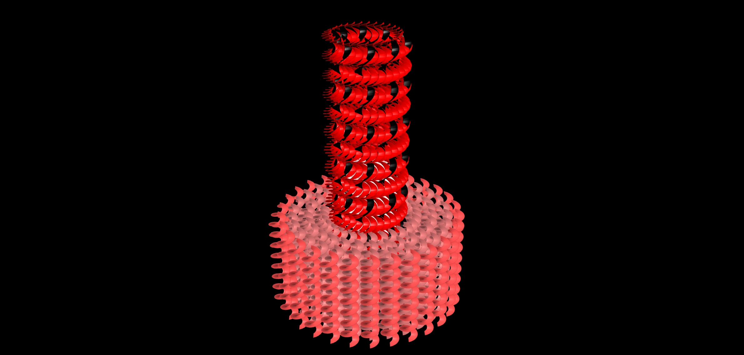
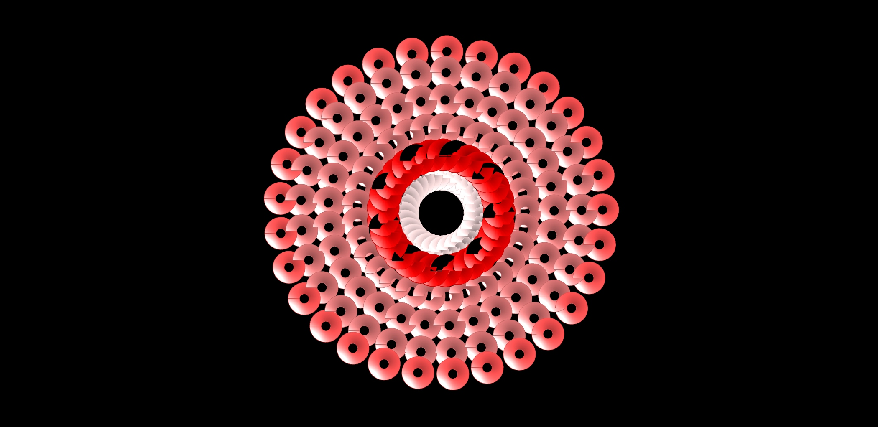
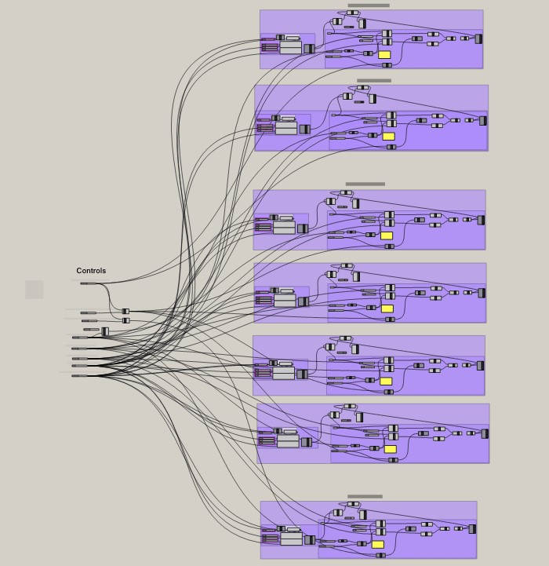
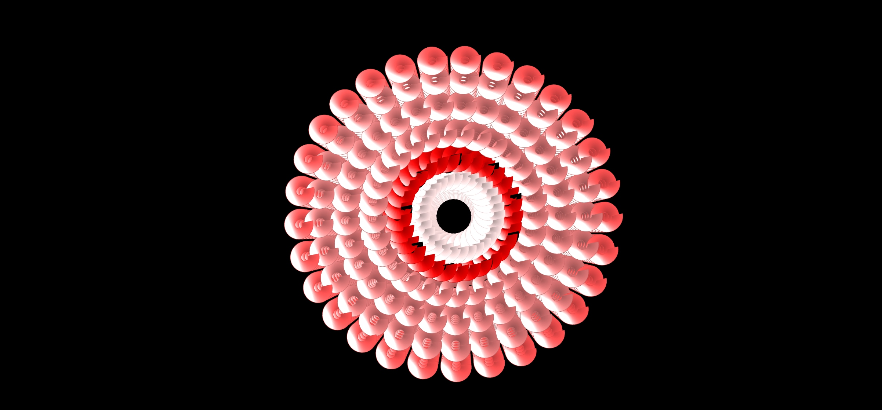
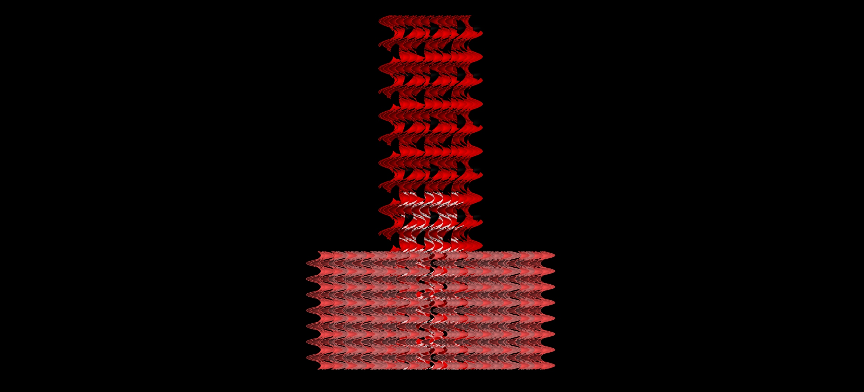
P#
<Computational Design Thinking>
<Generative Design>
P#
<Building Process Part 3>
Picture 01 shows the full Grasshopper code for the 3D model, with each separate group of Grasshopper code representing a duplicate layer of the circle-spiral model (as shown in picture 01 of the previous slide). The completed 3D model consists of a total of 7 layers of the circle-spiral model, with the top group of code representing the taller, red inner cylinder, the second top group of code representing the taller, black inner cylinder, the next 4 groups of code representing the 4 layers of shorter, pink middle cylinders, and the bottom group of code representing the shorter, darker pink outer cylinder.
Picture 02 to 05 displays the 3D model from various angles, perspective view (picture 02), top view (picture 03), bottom view (picture 04) and side view (picture 05).
1/8
02
03
1/8
01
1/8
1/4
04
Captions
01 Complete Grasshopper code of the 3D model
02 Perspective view of the 3D model
03 Top view of the 3D model
04 Bottom view of the 3D model
05 Side view of the 3D model
05
1/8

Slide 5
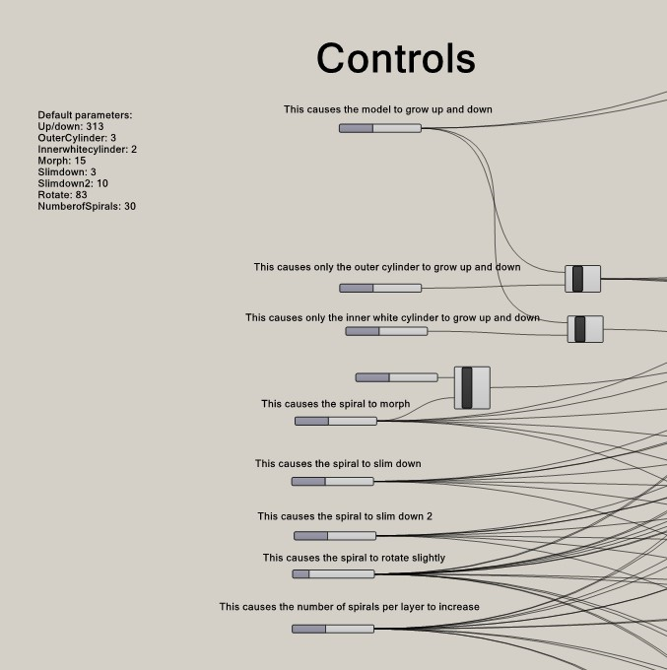
P#
<Computational Design Thinking>
<Generative Design>
P#
References
<Animation Process Part 1>
In the Grasshopper code for the 3D model, there are many wiring that are coming from the ‘Controls’ section of the Grasshopper code to the individual groups of code (which represents a layer of the circle-spiral model within our 3D model), which is where all the number sliders are located at, that controls various numerical values in the string of commands in the Grasshopper code.
There is a lot of wiring coming from every single group of code, where I joined similar parts of the separate groups code into one main number slider so I can manipulate the shape of all the circle-spiral model layer and hence the full 3D model at once in order to create the GIF animations, rather than having to individually change the numerical value at that same part of code in every single group in order to achieve that same effect.
When the numerical value at specific parts of the Grasshopper code is changed, this gives rise to fascinating physical changes to the overall 3D model, as shown in the various GIF animations. (which will be shown and explained in the next 3 slides)
Picture 01 shows the ‘Controls’ section of the Grasshopper code. It consists of various number sliders which can be manipulated to create the fascinating physical changes to the 3D model. I did not create a GIF animation for every single physical changes for every number slider, only choosing the best few to create into GIF animations.
Picture 02 shows the physical change of rotation of the 3D model as the number slider that controls the phase of the circle of points is being changed.
01
altArch. “How to Create Rhino Animations (Fly through and Turntable)’” Youtube video. Dec 18, 2021 https://www.youtube.com/watch?v=o6h8K4mPWa0
1/2
02
Captions
01 Controls of the 3D model to create each of the animations in Grasshopper of the 3D model
02 Rotating of the 3D model

Slide 6
P#
<Computational Design Thinking>
<Generative Design>
P#
<Animation Process Part 2>
Picture 01 shows the physical change of morphing of the 3D model as the number slider that controls how much the spiral model rotates is being changed. (when the number slider is 0, the spiral model does not rotate, causing the spiral model to just look like a straight line).
Picture 02 shows the physical change of a gradually increasing number of spiral count on every layer (except for the taller, black inner layer) of the circle-spiral model of the 3D model as the number slider that controls the number of points on the circle of points is being changed.
There are some other GIF animations not yet explained in this presentation that I would like to explain here as well.
The GIF animation in the cover page shows the physical change of growing height of the 3D model, while keeping the height difference of the outer layers and inner layers proportional, as the number slider that controls the height of each spiral model is being changed. The height difference of the outer layers, inner layers and the inner white layer is maintained at the ratio of 1:3:2 through the ‘Division’ function.
In the next slide, picture 01 shows the physical change of the taller, inner red layer expanding outwards of the 3D model as the number slider that controls the radius of the circle of points is being changed.
In the next slide, picture 02 and picture 03 shows the physical change of slimming variation 1 and slimming variation 2 respectively of the 3D model.
Each spiral model is able to ‘slim’ down because the spiral model is actually made up of 2 identical spirals of points, with a plane connected between these 2 spiral of points to create the spiral model. The spiral model is able to ‘slim’ down in 2 different variations when each of the 2 number sliders that controls the offset of each of the spiral of points is changed.
01
02
Captions
01 Morphing of the 3D model
02 Increasing the number of spirals for every layer of the 3D model

Slide 7
P#
<Computational Design Thinking>
<Generative Design>
P#
01
02
4/4
03
Captions
01 Expanding red layer of the 3D model 02 Slimming variation 1 of the 3D model
03 Slimming variation 2 of the 3D model

